Slide 1
BBM 301 – Programming Languages Lecture 1

Slide 2
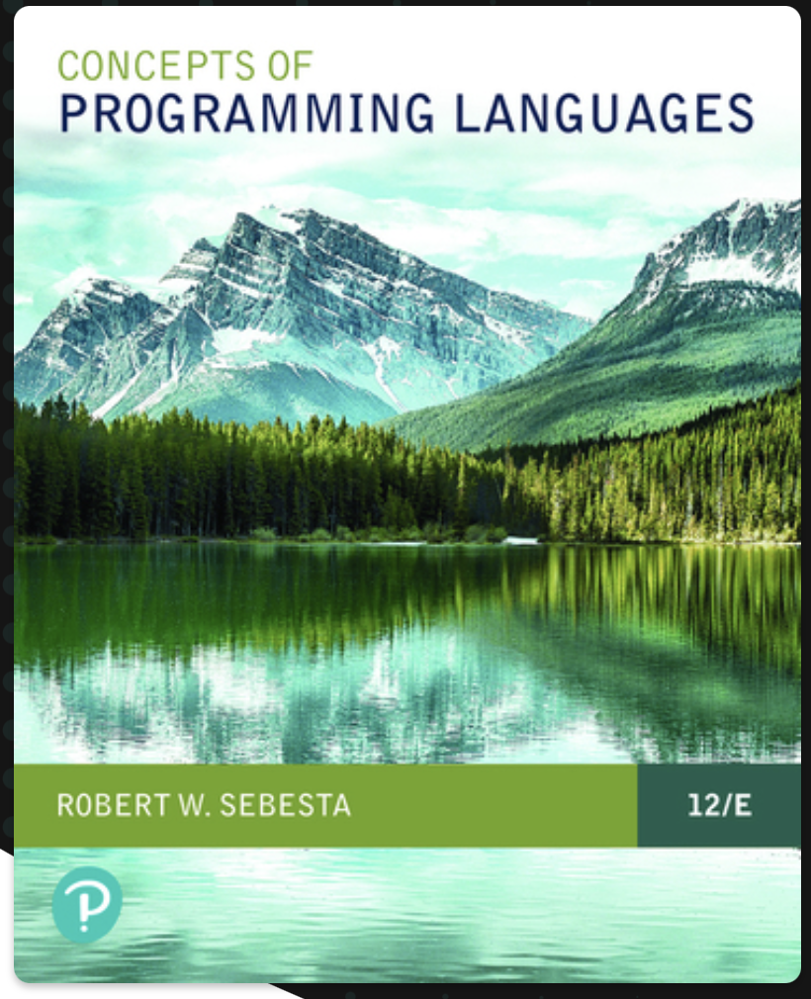
General Information
Webpage: http://web.cs.hacettepe.edu.tr/~bbm301
Textbook:
Robert W. Sebesta,
“Concepts of Programming Languages”,
Pearson, 12th Edition (also 11th is OK)
Time and Place:
Thursdays 09:40 – 12:30
Communication:
We will use Piazza https://piazza.com/hacettepe.edu.tr/fall2023/bbm301

Slide 3
Topics
Introduction to Programming Languages
Names, Bindings, Scope
Syntax and Semantics
Regular Expressions
Functional Languages
Data Types
Expressions, Assignments, Control Statements
Subprograms
Implementing Subprograms
Logic Languages

Slide 4
Grading Policy (Tentative)
30% Midterm exam 1
30% Midterm exam 2
40% Final exam

Slide 5
Lecture 1: Introduction to Programming Languages

Slide 6
What is a (Programming) Language?
A language is a vocabulary and set of grammatical rules for communication between people.
A programming language is a vocabulary and set of grammatical rules for instructing a computer to perform specific tasks. (Definition from webopedia)

Slide 7
Why Study Programming Languages?
One or two languages is not enough for a computer scientist.
You should know
the general concepts beneath the requirements
choices in designing programming languages.

Slide 8
Q: How many Programming Languages do you know?

Slide 9
How many programming languages are out there?
700 + Source: Wikipedia (excluding dialects of BASIC)
https://en.wikipedia.org/wiki/List_of_programming_languages

Slide 10
New Languages will Keep Coming
Notes:
10

Slide 11
Be prepared to program in new languages
Languages undergo constant change
FORTRAN 1953
ALGOL 60 1960
C 1973
C++ 1985
Java 1995
Evolution steps: 12 years per widely adopted language
are we overdue for the next big one?
... or is the language already here?
Hint: are we going through a major shift in what computation programs need to express?
your answer here:
Python
11
Notes:
11

Slide 12
Language as a thought shaper
We will cover less traditional languages, too.
The reason:
A language that doesn't affect the way you think about programming, is not worth knowing.
an Alan Perlis epigram <http://www.cs.yale.edu/quotes.html>
One of thought-shaper languages is Prolog.
You will both program in it and implement it.

Slide 13
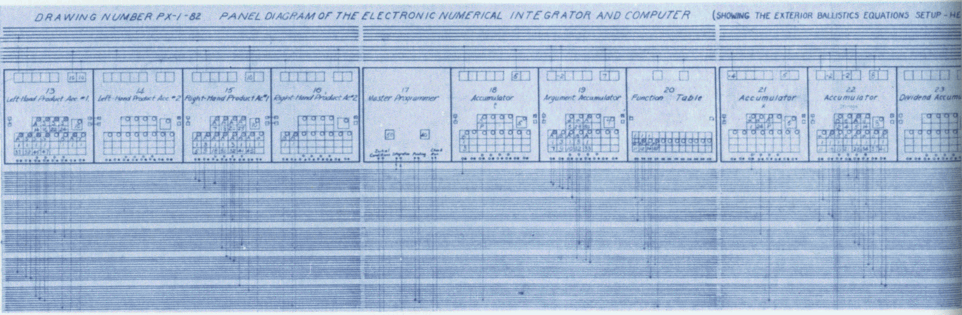
ENIAC (1946, University of Philadelphia)
ENIAC program for external ballistic equations:
Slide from Ras Bodik
13
Notes:
13
ENIAC (/ˈɛniæk/; Electronic Numerical Integrator and Computer)^{[1][2]} was the first programmable, electronic, general-purpose digital computer.
ENIAC could be programmed to perform complex sequences of operations, including loops, branches, and subroutines. However, instead of the stored-program computers that exist today, ENIAC was just a large collection of arithmetic machines, which originally had programs set up into the machine^{[32]} by a combination of plugboard wiring and three portable function tables (containing 1200 ten-way switches each).^{[33]} The task of taking a problem and mapping it onto the machine was complex, and usually took weeks.
Atanasoff-Berry Computer (IOWA State College)
1946
ENIAC was unveiled in Philadelphia. ENIAC represented still a stepping stone towards the true computer, for differently than Babbage, Eckert and Mauchly, although they knew that the machine was not the ultimate in the state-of-the-art technology, completed the construction. ENIAC was programmed through the rewiring the interconnections between the various components and included the capability of parallel computation. ENIAC was later to be modified into a stored program machine, but not before other machines had claimed the claim to be the first true computer. 1946 was the year in which the first computer meeting took place, with the University of Pennsylvania organizing the first of a series of "summer meetings" where scientists from around the world learned about ENIAC and their plans for EDVAC. Among the attendees was Maurice Wilkes from the University of Cambridge who would return to England to build the EDSAC.
Later that year Eckert and Mauchly, in a patent dispute with the University of Pennsylvania, left the University to establish the first computer company -- Electronic Control Corp. with a plan to build the Universal Automatic Computer (UNIVAC). After many crises they built the BINAC for Northrup Aviation, and were taken over by Remington-Rand before the UNIVAC was completed. At the same time the Electronic Research Associates (ERA) was incorporated in Minneapolis and took their knowledge of computing devices to create a line of computers; later ERA was also assimilated into Remington-Rand.

Slide 14
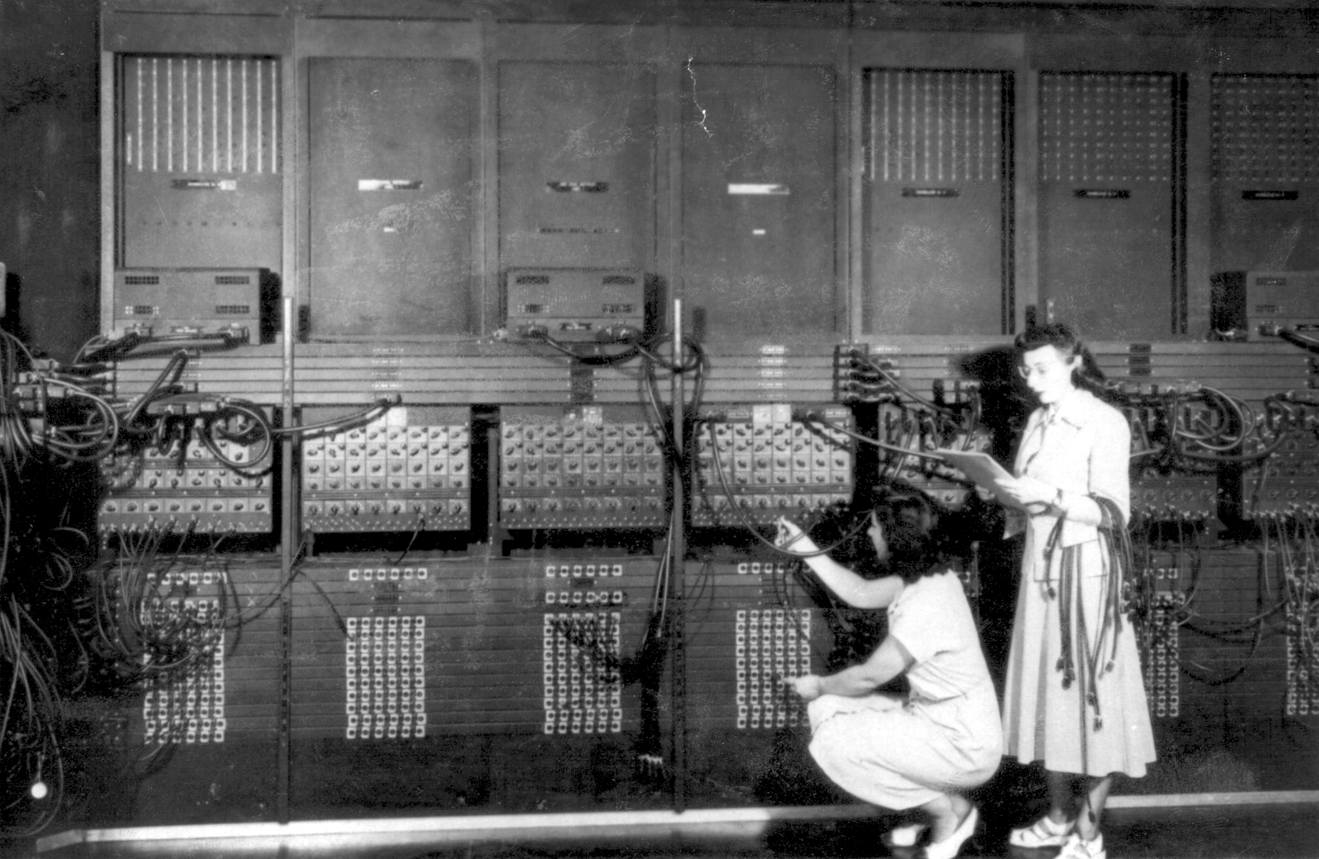
Programming the ENIAC
Slide from Ras Bodik
14
Notes:
14

Slide 15
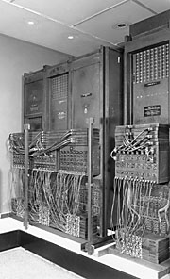
ENIAC (1946, Univ. of Philadelphia)
programming done by
rewiring the interconnections
to set up desired formulas, etc
Problem (what’s the tedious part?)
programming = rewiring
slow, error-prone
solution:
store the program in memory!
birth of von Neuman paradigm
Slide from Ras Bodik
15
Notes:
15
1946
ENIAC was unveiled in Philadelphia. ENIAC represented still a stepping stone towards the true computer, for differently than Babbage, Eckert and Mauchly, although they knew that the machine was not the ultimate in the state-of-the-art technology, completed the construction. ENIAC was programmed through the rewiring the interconnections between the various components and included the capability of parallel computation. ENIAC was later to be modified into a stored program machine, but not before other machines had claimed the claim to be the first true computer. 1946 was the year in which the first computer meeting took place, with the University of Pennsylvania organizing the first of a series of "summer meetings" where scientists from around the world learned about ENIAC and their plans for EDVAC. Among the attendees was Maurice Wilkes from the University of Cambridge who would return to England to build the EDSAC.
Later that year Eckert and Mauchly, in a patent dispute with the University of Pennsylvania, left the University to establish the first computer company -- Electronic Control Corp. with a plan to build the Universal Automatic Computer (UNIVAC). After many crises they built the BINAC for Northrup Aviation, and were taken over by Remington-Rand before the UNIVAC was completed. At the same time the Electronic Research Associates (ERA) was incorporated in Minneapolis and took their knowledge of computing devices to create a line of computers; later ERA was also assimilated into Remington-Rand.

Slide 16
Reasons for Studying Concepts of Programming Languages
Increased ability to express ideas
Improved background for choosing appropriate languages
Increased ability to learn new languages
Better understanding of significance of implementation
Better use of languages that are already known
Overall advancement of computing
Ability to design new languages
Notes:
16

Slide 17
Reasons for Studying Concepts of Programming Languages

Slide 18
Increased Ability to Express Ideas
Natural languages:
The depth at which people think is influenced by the expressive power of the language.
The more appropriate constructs you have, the easier it is to communicate.
It is difficult for people to conceptualize structures that they cannot describe verbally.

Slide 19
Increased Ability to Express Ideas
Programming Languages:
This is similar for PL’s. The language in which you develop software puts limits on the kinds of data structures, control structures and abstractions that can be used.
Awareness of a wider variety of programming language features can reduce such limitations in software development.
Programmers increase the range of software development by learning new language constructs.
For example, if you learn associate arrays in Perl, you can simulate them in C.

Slide 20
Improved background for choosing appropriate languages
Not every programming language can be suitable for all the software requirements.
Many programmers learn one or two languages specific to the projects.
Some of those languages may no longer be used.
When they start a new project they continue to use those languages which are old and not suited to the current projects.

Slide 21
Improved background for choosing appropriate languages
However another language may be more appropriate to the nature of the project.
Lots of text processing -> Perl may be a good option.
Lots of matrix processing -> MATLAB can be used.
If you are familiar with the other languages, you can choose better languages.
Studying the principles of PLs provides a way to judge languages:
“The advantages of Perl for this problem are…..”,“The advantages of Java are….”

Slide 22
Increased ability to learn new languages
Programming languages are still evolving
Many languages are very new, new languages can be added in time.
If you know the programming language concepts you will learn other languages much easier.
For example, if you know concept of object oriented programming, it is easier to learn C++ after learning Java
Just like natural languages,
The better you know the grammar of a language, the easier you find to learn a second language.
learning new languages actually causes you to learn things about the languages you already know

Slide 23
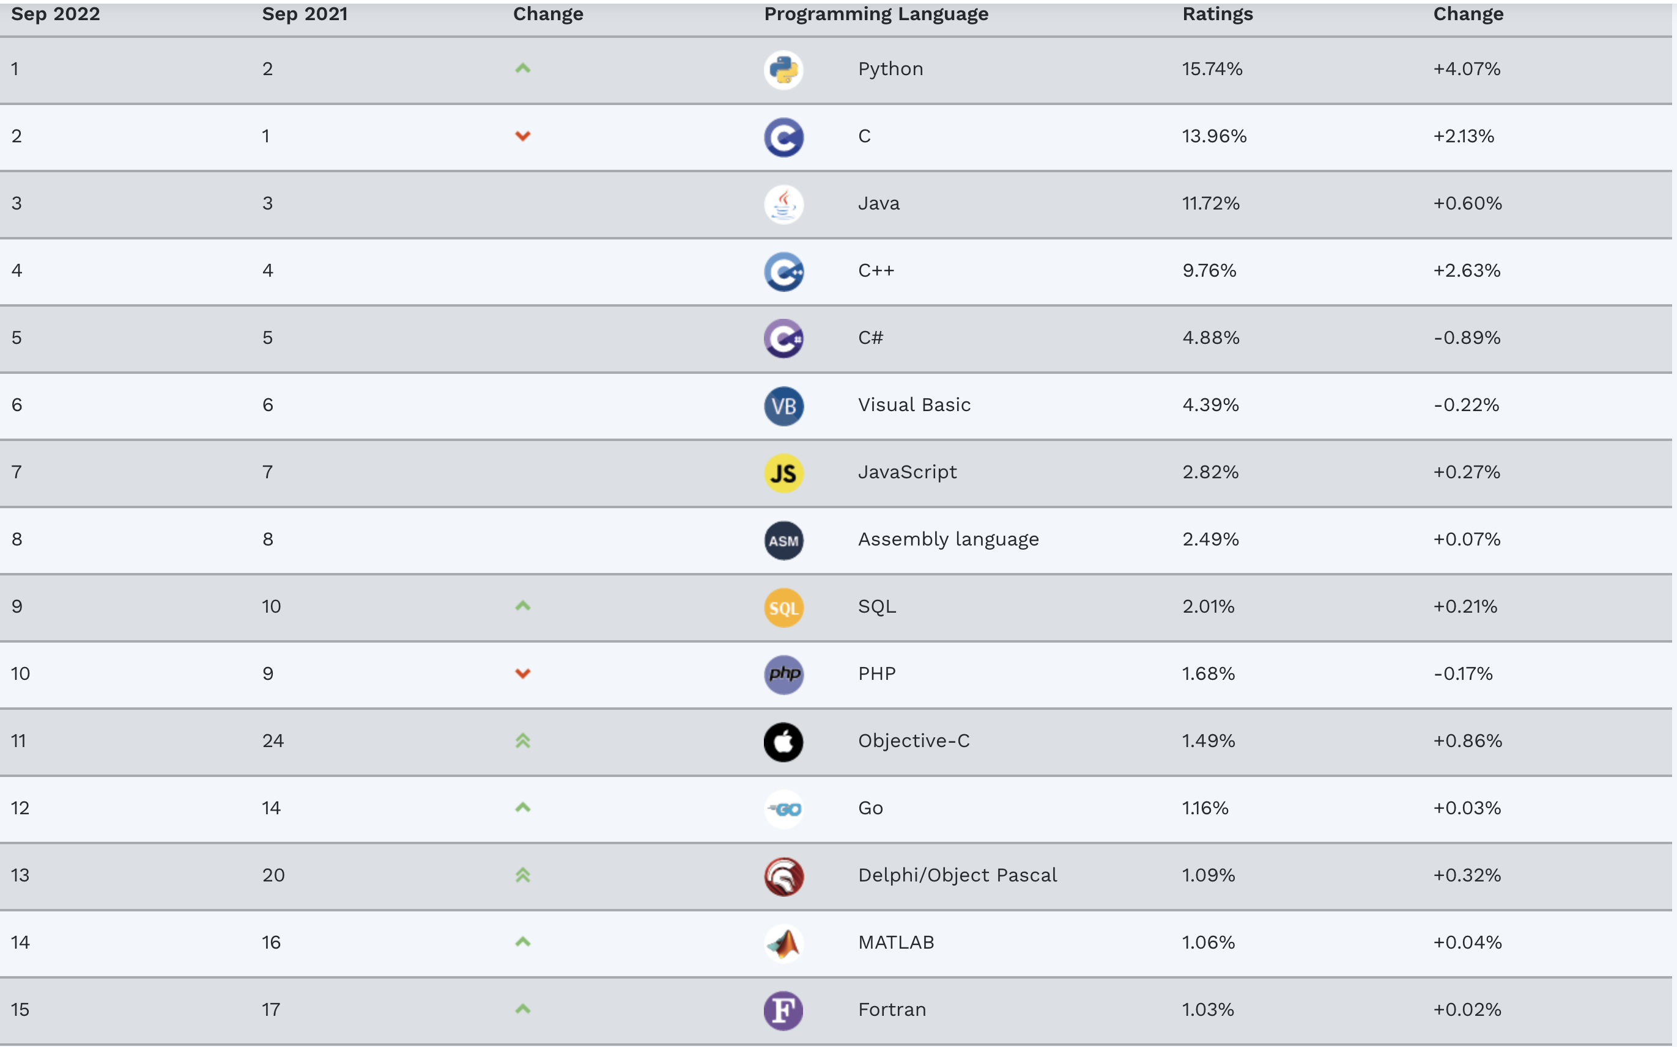
Languages in common use (2022)

Slide 24
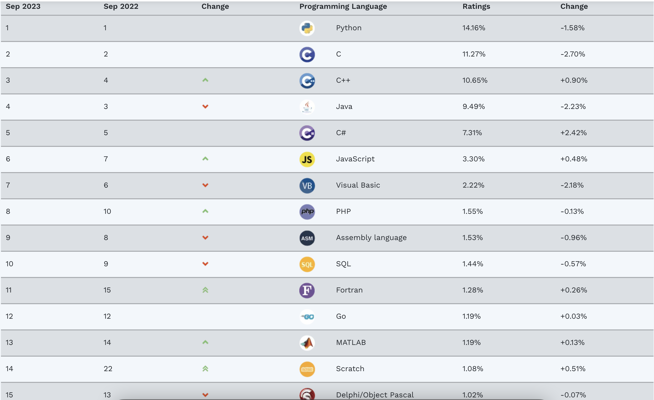
Languages in common use (2023)

Slide 25
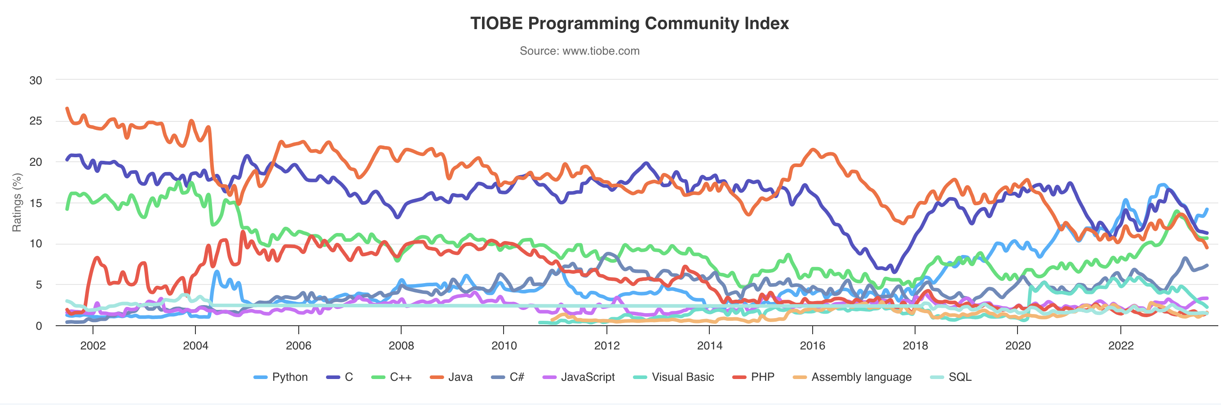
Languages in common use (today)
TIOBE programming community index

Slide 26
Better understanding of significance of implementation
The best programmers are the ones having at least understanding of how things work under the hood
Understand the implementation issues
You can simply write a code and let the compiler do everything, but knowing implementation details helps you to use a language more intelligently and write the code that is more efficient
Also, it allows you to visualize how a computer executes language constructs
Cost optimization; e.g. recursion is slow

Slide 27
Better use of languages that are already known
Many programming languages are large and complex
It is uncommon to know all the features
By studying the concepts of programming languages, programmers can learn about previously unknown parts of the languages easily.

Slide 28
Overall advancement of computing
New ways of thinking about computing, new technology, hence need for new appropriate language concepts
Not to repeat history
Although ALGOL 60 was a better language (with better block structure, recursion, etc) than FORTRAN, it did not become popular. If those who choose languages are better informed, better languages would be more popular.
You may need to design a special purpose language to enter the commands for a software that you develop.
A language for an robotics interface

Slide 29
Develop your own language
Slide from Ras Bodik
Are you kidding? No. Guess who developed:
PHP
Ruby
JavaScript
Perl
Done by smart hackers like you
in a garage
not in academic ivory tower
Our goal: learn good academic lessons
so that your future languages avoid known mistakes

Slide 30
Ability to Design New Languages
You may need to design a special purpose language to enter the commands for a software that you develop.
A language for an robotics interface
Studying PL concepts will give you the ability to design a new language suitable and efficient for your software requirements.

Slide 31
Language Evaluation Criteria
The main criteria needed to evaluate various constructs and capabilities of programming languages
Readability: the ease with which programs can be read and understood
Writability: the ease with which a language can be used to create programs
Reliability: conformance to specifications (i.e., performs to its specifications)
Cost: the ultimate total cost
Notes:
31

Slide 32
Language Evaluation Criteria
The main criteria needed to evaluate various constructs and capabilities of programming languages
Readability
Writability
Reliability
Cost
Notes:
32

Slide 33
Readability
“Ease with which programs can be read and understood”
Readability is important for maintenance
Characteristics that contribute to readability:
Overall simplicity
Orthogonality
Control statements
Data types and structures
Syntax Considerations

Slide 34
Evaluation Criteria: Readability
Overall simplicity
A manageable set of features and constructs
Minimal feature multiplicity
Minimal operator overloading
Orthogonality
A relatively small set of primitive constructs can be combined in a relatively small number of ways
Every possible combination is legal
Data types
Adequate predefined data types
Syntax considerations
Identifier forms: flexible composition
Special words and methods of forming compound statements
Form and meaning: self-descriptive constructs, meaningful keywords
Notes:
34

Slide 35
Overall Simplicity
A manageable set of features and constructs
Large number of basic components - difficult to learn
Minimal feature multiplicity
Feature multiplicity: having more than one way to accomplish an operation
e.g. In Java
count = count + 1
count += 1
count ++
++count

Slide 36
Overall Simplicity
Minimal operator overloading
Operator overloading: a single operator symbol has more than one meaning
This can lead to reduced readability if users are allowed to create their own and do not do it sensibly
Example:
using + for integer and floating point addition is acceptable and contributes to simplicity
but if a user defines + to mean the sum of all the elements of two single dimensional arrays is not, different from vector addition
Simplest does not mean the best
Assembly languages: Lack the complex control statements, so program structure is less obvious

Slide 37
Orthogonality
A relatively small set of primitive constructs can be combined in a relatively small number of ways to build the control and data structures of the language
Every possible combination of primitives is legal and meaningful.
Example:
Four primitive data types : integer, float, double and character
Two type operators : array and pointer
If the two type operators can be applied to themselves and the four primitive data types, a large number of data structures can be defined
However, if pointers were not allowed to point to arrays, many of those useful possibilities would be eliminated

Slide 38
Orthogonality
Example : Adding two 32-bit integers residing in memory or registers, and replacing one of them with the sum
IBM (Mainframe) Assembly language has two instructions:
A Register1, MemoryCell1
AR Register1, Register2
meaning
Register1 ← contents(Register1) + contents(MemoryCell1)
Register1 ← contents(Register1) + contents(Register2)
VAX Assembly language has one instruction:
ADDL operand1, operand2
meaning
operand2 ← contents(operand1) + contents(operand2)
Here, either operand can be a register or a memory cell.
More restricted
Less writable
Not orthogonal
orthogonal
Notes:
VAX instruction design is orthogonal
Because a single instruction can use either registers or memory cells as the operands
IBM design is not orthogonal
Only two operand combinations are legal out of for possibilities and two require different instructions, A and AR
More restricted and less writable (you cannot add two values and store the sum in memory location)
More difficult to learn because of the restrictions and the additional instructions

Slide 39
Orthogonality
Pascal is not an orthogonal language, because
A function cannot return a record (only unstructured types allowed),
A file must be passed as a var parameter,
Formal parameter types must be named (cannot be type descriptions)
Compound statements are formed by begin-end pair, except repeat-until
C is not an orthogonal language, because
records (structs) can be returned from functions but arrays cannot
a member of a structure can be any type but not void or structure of the same type
a member of an array can be any type but not void or function

Slide 40
Orthogonality
Orthogonality is closely related to simplicity
The more orthogonal the design of a language, the fewer exceptions the language rules require
Too much orthogonality can cause problems as well:
ALGOL68 is the most orthogonal language.
Every construct has a type
Most constructs produce values
This may result in extremely complex constructs,
Ex: A conditional can appear as the left side of an assignment statement, as long as it produces a location:
(if (A<B) then C else D) := 3
This extreme form of orthogonality leads to unnecessary complexity
Functional languages offer a good combination of simplicity and orthogonality.

Slide 41
Data Types and Structures
Facilities for defining data types and data structures are helpful for readability
If there is no boolean type available then a flag may be defined as integer:
found = 1 (instead of found = true)
May mean something is found as boolean or what is found is 1
An array of record type is more readable than a set of independent arrays

Slide 42
Syntax considerations
Identifier Forms:
restricting identifier length is bad for readability.
FORTRAN77 identifiers can have at most 6 characters.
ANSI BASIC : an identifier is either a single character or a single character followed by a single digit.
Availability of word concatenating characters (e.g., _ ) is good for readability.
Special Words: Readability is increased by special words(e.g., begin, end, for).
In PASCAL and C, end or } is used to end a compound statement. It is difficult tell what an end or } terminates.
However, ADA uses end if and end loop to terminate a selection and a loop, respectively.

Slide 43
Syntax Considerations
Forms and Meaning: Forms should relate to their meanings. Semantics should directly follow from syntax.
For example,
sin(x) => should be the sine of x,
not the sign of x or cosign of x.
grep is hard to understand for the people who are not familiar with using regular expressions
grep : g/reg_exp/p
=> /reg_exp/ : search for that reg_exp
g: scope is whole file , make it global
p:print

Slide 44
Language Evaluation Criteria
The main criteria needed to evaluate various constructs and capabilities of programming languages
Readability
Writability
Reliability
Cost
Notes:
44

Slide 45
Writability
Ease of creating programs
Most of the characteristics that contribute to readability also contribute to writability
Characteristics that contribute to writability
Simplicity and Orthogonality
Support for abstraction
Expressivity
Writability of a language can also be application dependent

Slide 46
Writability
Simplicity and orthogonality
Few constructs, a small number of primitives, a small set of rules for combining them
Support for abstraction
The ability to define and use complex structures or operations in ways that allow details to be ignored
Expressivity
A set of relatively convenient ways of specifying operations
Strength and number of operators and predefined functions

Slide 47
Simplicity and orthogonality
Simplicity and orthogonality are also good for writability.
When there are large number of constructs, programmers may not be familiar with all of them, and this may lead to either misuse or disuse of those items.
A smaller number of primitive constructs (simplicity) and consistent set of rules for combining them (orthogonality) is good for writability
However, too much orthogonality may lead to undetected errors, since almost all combinations are legal.

Slide 48
Support for abstraction
Abstraction: ability to define and use complicated structures and operations in ways that allows ignoring the details.
PLs can support two types of abstraction:
Process abstraction: subprograms
Data abstraction: trees, linked lists, etc.
Abstraction is the key concept in contemporary programming languages
The degree of abstraction allowed by a programming language and the naturalness of its expressions are very important to its writability.

Slide 49
Process abstraction
The simplest example of abstraction is subprograms (e.g., methods).
You define a subprogram, then use it by ignoring how it actually works.
Eliminates replication of the code
Ignores the implementation details
e.g. sort algorithm

Slide 50
Data abstraction
As an example of data abstraction, a tree can be represented more naturally using pointers in nodes.
In FORTRAN77, where pointer types are not available, a tree can be represented using 3 parallel arrays, two of which contain the indexes of the offspring, and the last one containing the data.

Slide 51
Expressivity
Having more convenient and shorter ways of specifying computations.
For example, in C,
count++;
is more convenient and expressive than
count = count + 1;
for is more easier to write loops than while

Slide 52
Language Evaluation Criteria
The main criteria needed to evaluate various constructs and capabilities of programming languages
Readability
Writability
Reliability
Cost
Notes:
52

Slide 53
Reliability
Reliable: it performs to its specifications under all conditions
Type checking
Testing for type errors
Exception handling
Intercept run-time errors and take corrective measures
Aliasing
Presence of two or more distinct referencing methods for the same memory location
Readability and writability
The easier a program to write, the more likely it is correct.
Programs that are difficult to read are difficult both to write and modify.

Slide 54
Type Checking
Testing for type errors in a given program either by the compiler or during program execution
The compatibility between two variables or a variable and a constant that are somehow related (e.g., assignment, argument of an operation, formal and actual parameters of a method).
Run-time (Execution-time) checking is expensive.
Compile-time checking is more desirable.
The earlier errors in programs are detected, the less expensive it is to make the required repairs

Slide 55
Type Checking
Original C language requires no type checking neither in compilation nor execution time. That can cause many problems.
Current version required all parameters to be type-checked
For example, the following program in original C compiles and runs!
foo (float a) {
printf (“a: %g and square(a): %g\n”, a,a*a);
}
main () {
char z = ‘b’;
foo(z);
}
Output is : a: 98 and square(a): 9604

Slide 56
Exception Handling
The ability of a program
to intercept run-time errors, as well as other unusual conditions
to take corrective measures and continue
Ada, C++, and Java include extensive capabilities for exception handling, but in C and Fortran it is practically non-existent

Slide 57
Aliasing
Having two distinct referencing methods (or names) for the same memory cell.
It is a dangerous feature in a programming language.
Example: pointers in PASCAL and C
two different variables can refer to the same memory cell

Slide 58
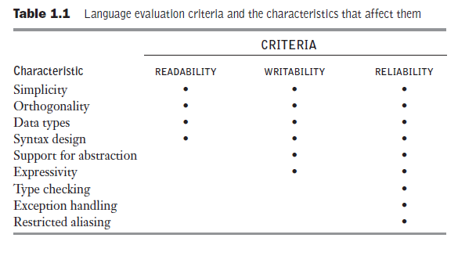

Slide 59
Language Evaluation Criteria
The main criteria needed to evaluate various constructs and capabilities of programming languages
Readability
Writability
Reliability
Cost
Notes:
59

Slide 60
Cost
Types of costs:
Cost of training the programmers: Function of simplicity and orthogonality, experience of the programmers.
Cost of writing programs: Function of the writability
Note: These two costs can be reduced in a good programming environment
Cost of compiling programs: cost of compiler, and time to compile
First generation Ada compilers were very costly

Slide 61
Cost
Cost of executing programs: If a language requires many run-time type checking, the programs written in that language will execute slowly.
Trade-off between compilation cost and execution cost.
Optimization: decreases the size or increases the execution speed.
Without optimization, compilation cost can be reduced.
Extra compilation effort can result in faster execution.
More suitable in a production environment, where compiled programs are executed many times

Slide 62
Cost
Cost of the implementation system. If expensive or runs only on expensive hardware it will not be widely used.
Cost of reliability – important for critical systems such as a power plant or X-ray machine
Cost of maintaining programs. For corrections, modifications and additions.
Function of readability.
Usually, and unfortunately, maintenance is done by people other that the original authors of the program.
For large programs, the maintenance costs is about 2 to 4 times the development costs.

Slide 63
Other Criteria for Evaluation
Portability: The ease with which programs can be moved from one implementation to another
Generality: The applicability to a wide range of applications
Well-definedness: The completeness and precision of the language’s official definition

Slide 64
Language Design Trade-Offs
Reliability vs. cost of execution
Example: Java demands all references to array elements be checked for proper indexing, which leads to increased execution costs
Readability vs. writability
Example: APL provides many powerful operators for arrays(and a large number of new symbols), allowing complex computations to be written in a compact program but at the cost of poor readability
Writability (flexibility) vs. reliability
Example: C++ pointers are powerful and very flexible but are unreliable
Notes:
64

Slide 65
Home Exercise
How does Zen of Python relate to Language Evaluation criteria?

Slide 66
Programming Domains
Scientific Applications (first digital computers –1940s)
Large floating-point arithmetic, execution efficiency, arrays and matrices, counting loops
Examples: FORTRAN, ALGOL 60, C
Business Applications (1950s)
Producing elaborate reports, decimal numbers and character data
Examples: COBOL(1960s),Spreadsheets,Wordprocessors,Databases(SQL)
Artificial Intelligence
Symbolic programming (names rather than numbers, linked lists rather than arrays)
Examples: LISP(1959),PROLOG(early1970s)

Slide 67
Programming Domains (cont’d.)
Systems Programming
System software: Operating system and all of the programming support tools of a computer system
Efficient and fast execution, low-level features for peripheral device drivers
Examples: PLS/2(IBM Mainframe), BLISS (Digital), C (Unix)
Scripting Languages
List of commands (Script) to be executed is put in a file.
Examples:sh, csh, tcsh, awk, gawk, tcl, perl, javascript
Special-Purpose languages
Examples: RPG (Business Reports), SPICE (Simulation of Electronic Circuitry), SPSS (Statistics), Latex (Document preparation). HTML, XML (web prog.)

Slide 68
Language Categories
Imperative
Central features are variables, assignment statements, and iteration
Include languages that support object-oriented programming
Include scripting languages
Include the visual languages
Examples: C, Java, Perl, Visual BASIC .NET, C++
Functional
Main means of making computations is by applying functions to given parameters
Examples: LISP, Scheme, ML, F#
Logic
Rule-based (rules are specified in no particular order)
Example: Prolog
Markup/programming hybrid
Markup languages extended to support some programming
Examples: JSTL, XSLT
Notes:
68

Slide 69
Implementation Methods
Compilation
Programs are translated into machine language; includes JIT systems
Use: Large commercial applications
Pure Interpretation
Programs are interpreted by another program known as an interpreter
Use: Small programs or when efficiency is not an issue
Hybrid Implementation Systems
A compromise between compilers and pure interpreters
Use: Small and medium systems when efficiency is not the first concern

Slide 70
Watch the lecture recording on compilation and interpretation
From Piazza/resources

Slide 71
“Hello World” in different languages
https://www.geeksforgeeks.org/hello-world-in-30-different-languages/

Slide 72
Java
public class Hello {
public static void main(String[] args) {
System.out.println("Hello, world!");
}
}

Slide 73
Assembly Language
bdos equ 0005H ; BDOS entry point
start: mvi c,9 ; BDOS function: output string
lxi d,msg$ ; address of msg
call bdos ret ; return to CCP
msg$: db 'Hello, world!$'
end start

Slide 74
FORTRAN
PROGRAM
HELLO
WRITE(*,10)
10 FORMAT('Hello, world!')
STOP
END

Slide 75
COBOL
IDENTIFICATION DIVISION.
PROGRAM-ID. HELLO-WORLD.
ENVIRONMENT DIVISION.
DATA DIVISION.
PROCEDURE DIVISION.
DISPLAY "Hello, world!".
STOP RUN.

Slide 76
Ada
with Ada.Text_Io;
procedure Hello is
begin
Ada.Text_Io.Put_Line ("Hello, world!");
end Hello;

Slide 77
C
#include <stdio.h>
int main()
{
printf("Hello, world!\n");
return 0;
}

Slide 78
C++
#include <iostream>
int main()
{
std::cout << "Hello, world!\n";
}

Slide 79
C#
using System;
class HelloWorldApp
{
public static void Main()
{
Console.WriteLine("Hello, world!");
}
}

Slide 80
Scala
object HelloWorld extends App { println("Hello, World!")
}

Slide 81
LISP
(format t "Hello world!~%")

Slide 82
PERL
print "Hello, world!\n";

Slide 83
Prolog
write('Hello world'),nl.

Slide 84
Python
print("Hello World!")

Slide 85
Swift
import Swift
print(“Hello World!”)

Slide 86
HTML
<!DOCTYPE HTML PUBLIC "-//W3C//DTD HTML 4.01//EN"
"http://www.w3.org/TR/html4/strict.dtd">
<html>
<head>
<title>Hello, world!</title>
<meta http-equiv="Content-Type“ content="text/html;
charset=UTF-8">
</head>
<body>
<p>Hello, world!</p>
</body>
</html>

Slide 87
Summary
The study of programming languages is valuable for a number of reasons:
Increase our capacity to use different constructs
Enable us to choose languages more intelligently
Makes learning new languages easier
Most important criteria for evaluating programming languages include:
Readability, writability, reliability, cost

Slide 88
An optional exercise
List three new languages, or major features added to established major languages, that have appeared in the last seven years. For each language, answer with one sentence these questions:
Why did the languages appear? Or, why have these features been added? Often, a new language is motivated by technical problems faced by programmers. Sometimes the motivation for a new feature is cultural, related to, say, the educational background of programmers in a given language.
Who are the intended users of this language/feature? Are these guru programmers, beginners, end-users (non-programmers)?
Show a code fragment that you find particularly cool. The fragment should exploit the new features to produce highly readable and concise code.
Links that may help you start your exploration of the programming language landscape:
http://lambda-the-ultimate.org/
http://bit.ly/ddH47v
http://www.google.com

